Slide 1

Goal 11:
Sustainable Cities & Communities
Research Report Updates

Slide 2

Ensuring Sustainable Housing
for those living in extreme poverty in Southeast Asia
Expert chair: Douglas Lee

Slide 3
Update
Latest Events/Solutions:
https://www.treehugger.com/urban-design/hyperloopism-infecting-everything-its-time-sustainable-alternatives.html (Sustaniable Housing)
http://www.straitstimes.com/asia/three-principles-in-war-on-poverty (Extreme Poverty)
http://www.gulf-times.com/story/585490/Doha-to-host-conference-on-sustainable-development (Upcoming Event)
http://dsnews.com/daily-dose/03-17-2018/collaborating-sustainable-housing-industry (Upcoming Event)

Slide 4






Blocs
...And other countries would work together as proven through the interaction of ASEAN, which most SEA countries are a part of.. The countries in the top row are the countries with the most amount of money in SEA, while the bottom row is the countries with highest poverty rates or lowest contribution to the SDGs
http://asean.org/launched-publication-on-financing-the-sustainable-development-goals-in-asean/
https://www.rappler.com/world/regions/asia-pacific/188918-asean-report-poverty-philippines-indonesia
Brunei
Singapore
Thailand
Philippines
Laos
Indonesia

Slide 5

Addressing the role of climate change
on the development of urban areas facing
extreme weather events
Expert chair: Shawn Kao

Slide 6
Update
Research on threatened Coastal Cities (link)
Antarctica Model and Sea Level Projection (link)
Creative “future-proofing” (link)
Germany withdraws from Paris Agreement (link)

Slide 7
Major Involvement
Paris Climate Agreement
Signed by the entire world but the US
Promotes changes within each individual nation for less carbon-emission
Intergovernmental Panel on Climate Change
UN affiliated
Includes scientific research and studies based around climate change
Union of Concerned Scientists
Independent non-profit scientific advocacy of scientists that attempt to solve pressing issues

Slide 8
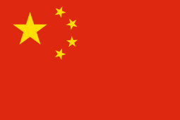





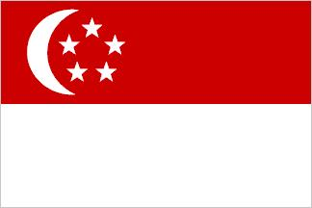

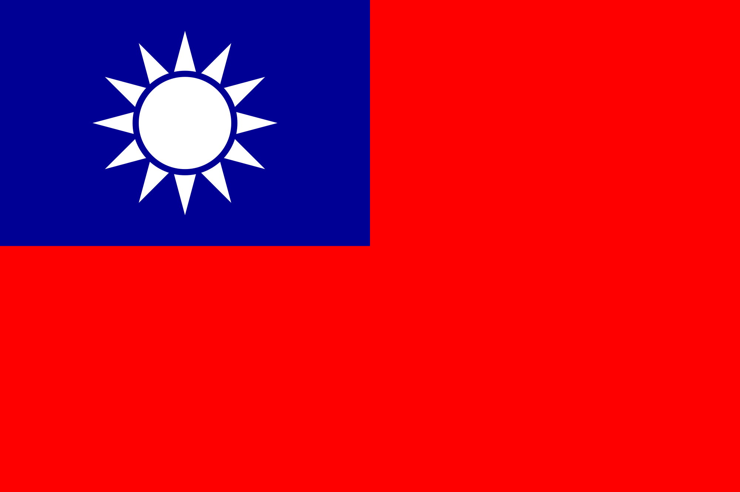
Blocs
Due to recent events, Germany and the US both undermines the international agreement of the Paris Climate Agreement. Hence, putting doubt in their bloc formations.

Slide 9

Clean water and sanitation
as a prerequisite to facilitating an adequate
social and economic living standard
Expert chair: Eugenia Lin

Slide 10
Update
Upcoming events
News
8th World Water Forum
Global WASH Cluster Annual Meeting 2018
International Decade
of Action
Click here for the website
And here for Launch Agenda
Click here for the World Water Day website
Click here for the website
Click here for further details
Click here for the website
•
Kenya’s Step Toward Better Sanitation
Water Shortage in Syria
Rohingya Refugees in need of Water and Sanitation
•
Click here for news article
Click here for news article
Click here and here for news articles

Slide 11
Major Involvement Organizations
High Level Panel on Water
Encourages evidence-based policies
Appeal water management to potential investors
Creates partnerships between governments, communities, the private sector and researchers
Link
United Nations International Children’s Emergency Fund (UNICEF)
Publishes country reports on humanitarian situation
Provides Water, Sanitation and Hygiene (WASH) facilities to all
For humanitarian situation reports search: UNICEF country humanitarian situation report year
Link to WASH page
United Nations Industrial Development Organization (UNIDO)
Initiated the “GEF-UNIDO Sustainable Cities: Integrated Approach Pilot (SCIAP)”
Targets waste management, water treatment, and urban planning in India
Link to UNIDO’s newest program
Link to source of funding

Slide 12





Blocs
...And other countries that are involved in refugee crises, these people are in desperate need to temporary clean water and sanitation facilities.
Syria
Myanmar
Yemen
...And other following plans that are aimed to improve underprivileged groups’ access to sanitation.
India
Kenya
Peru

